Slide 1
Information/Inspiration An investigation into data visualization as a creative practice

Slide 2
Week 1, Drawing Data

Slide 3
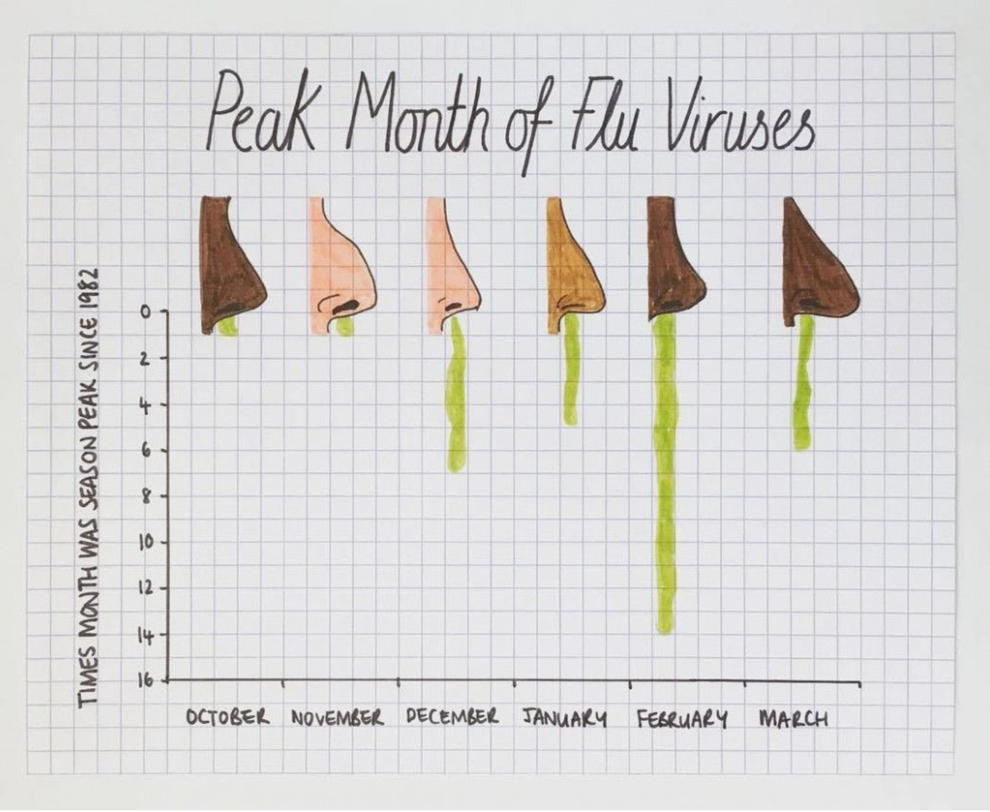
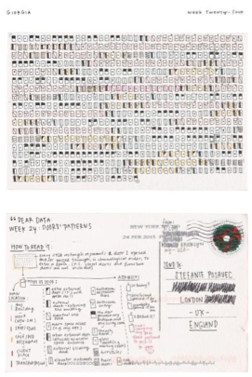
Inspiration: Giorgia Lupi & Mona Chalabi

Slide 4
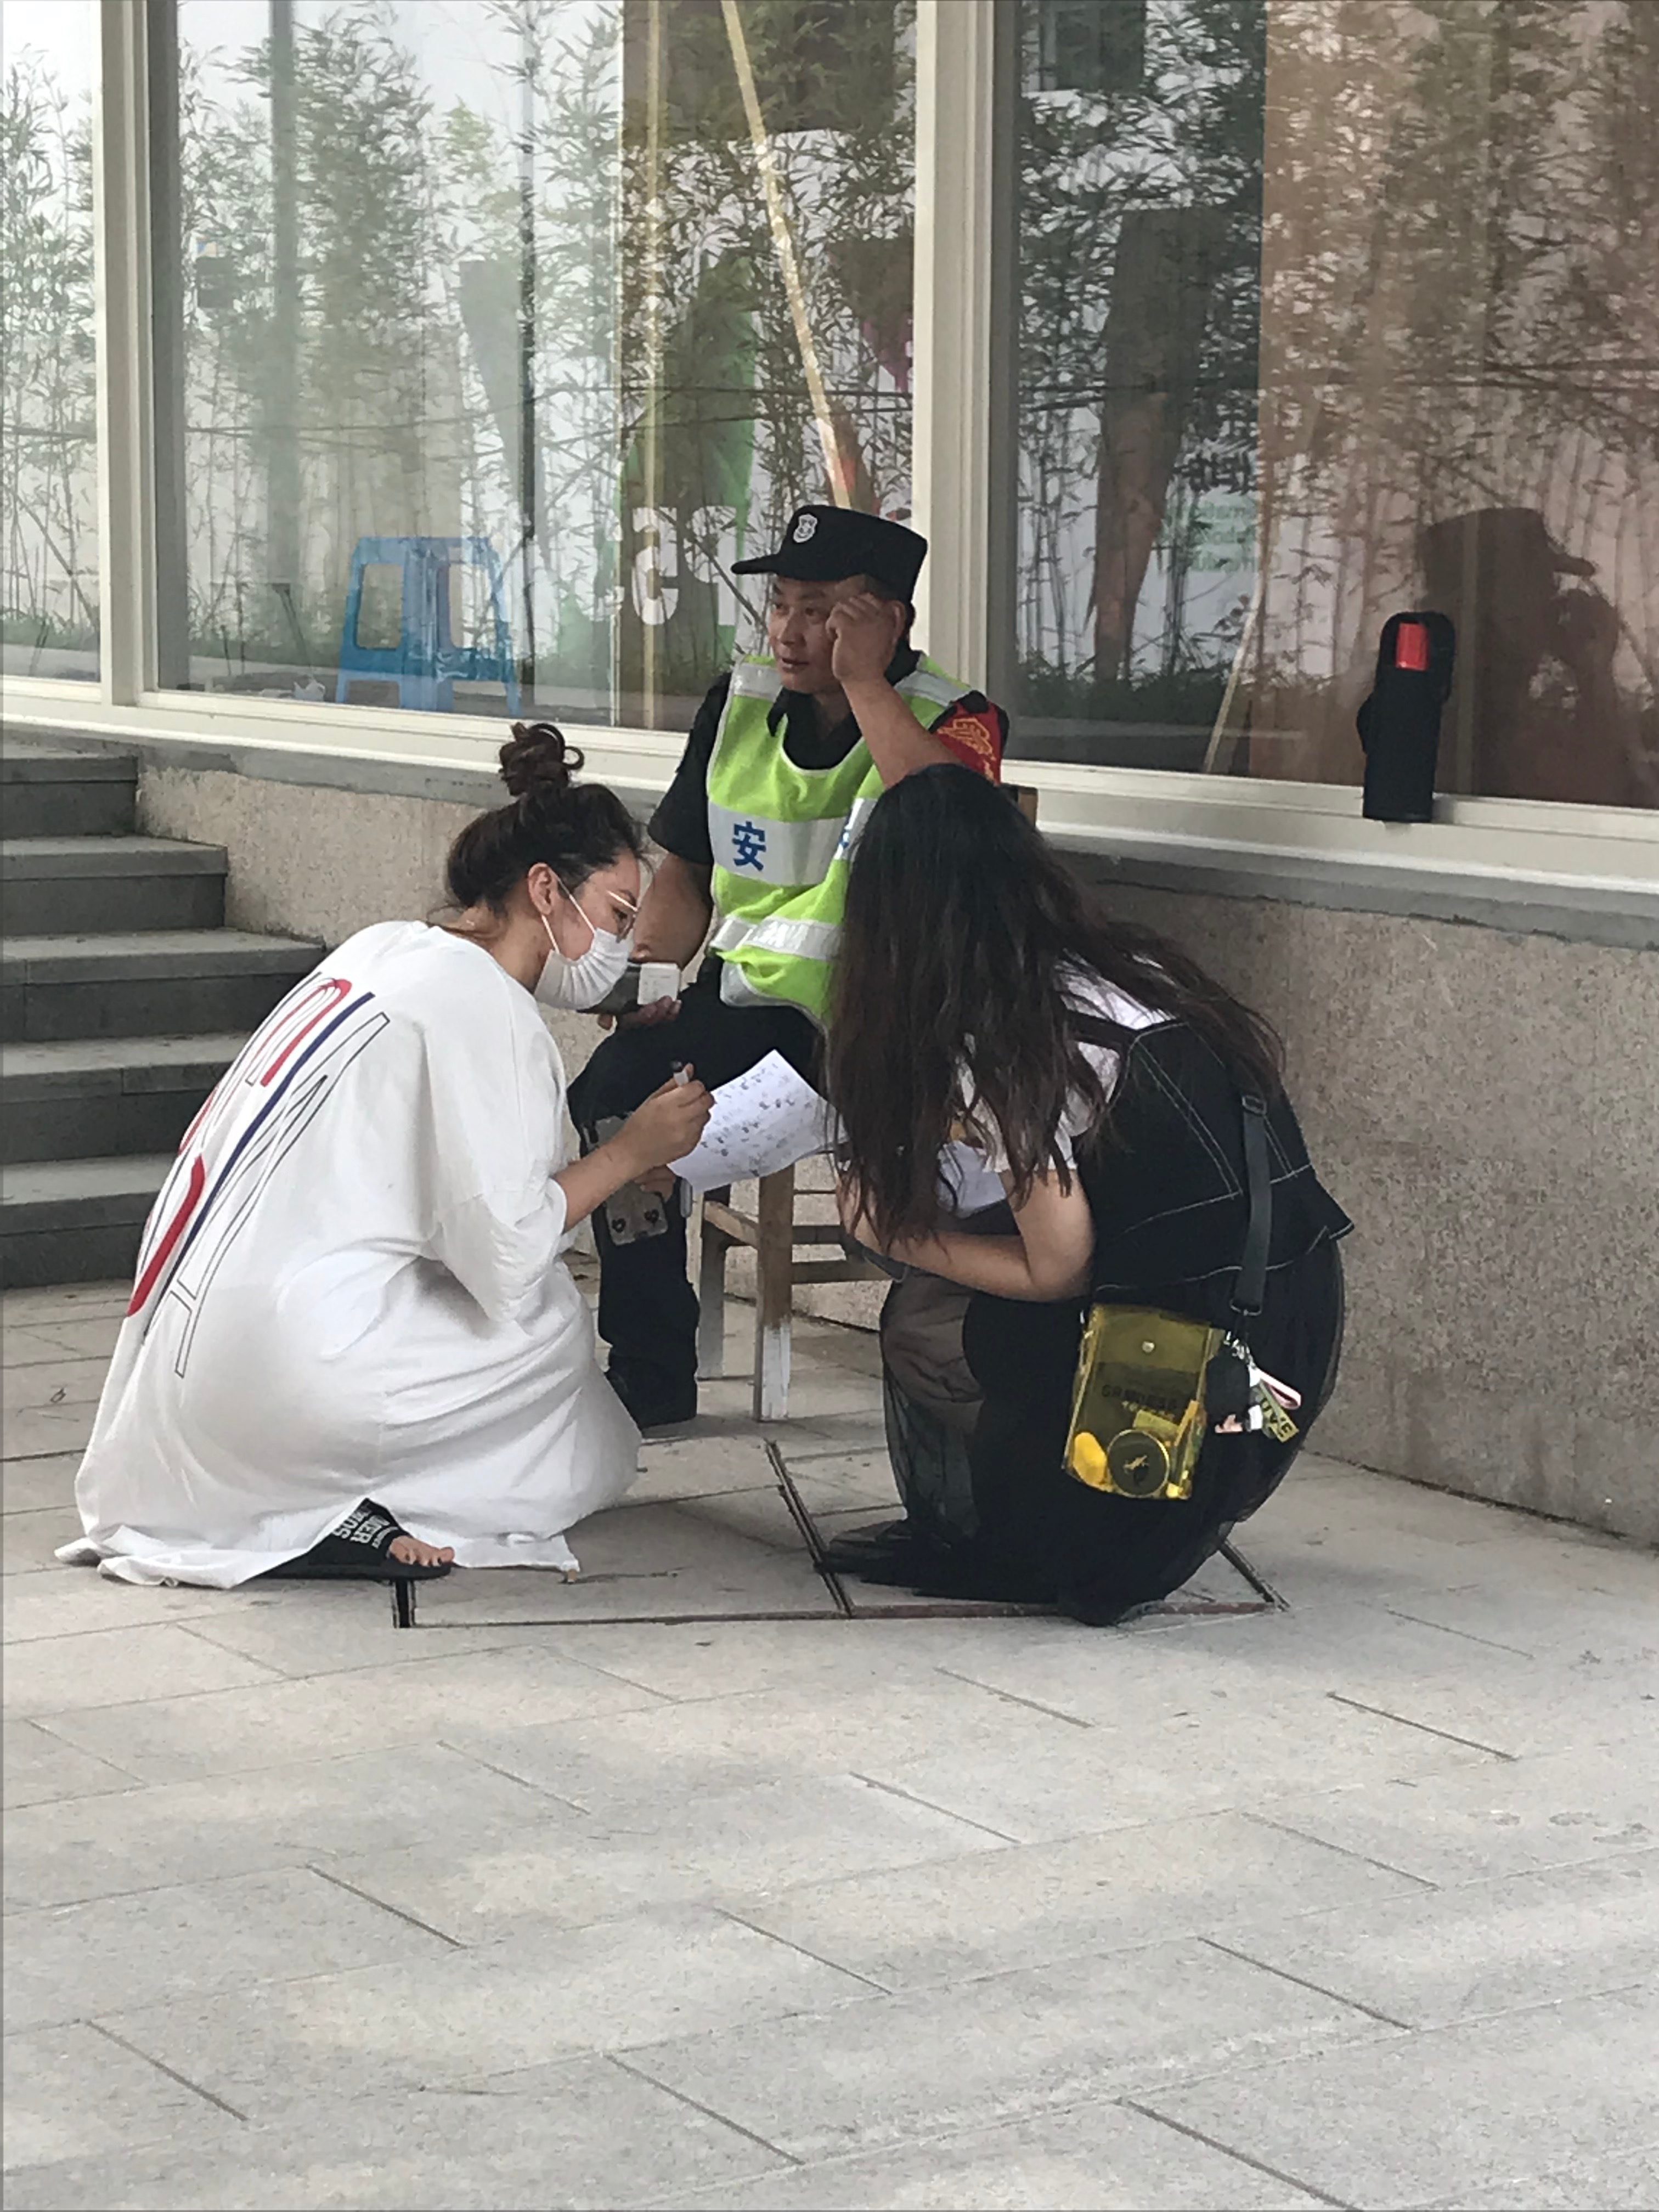
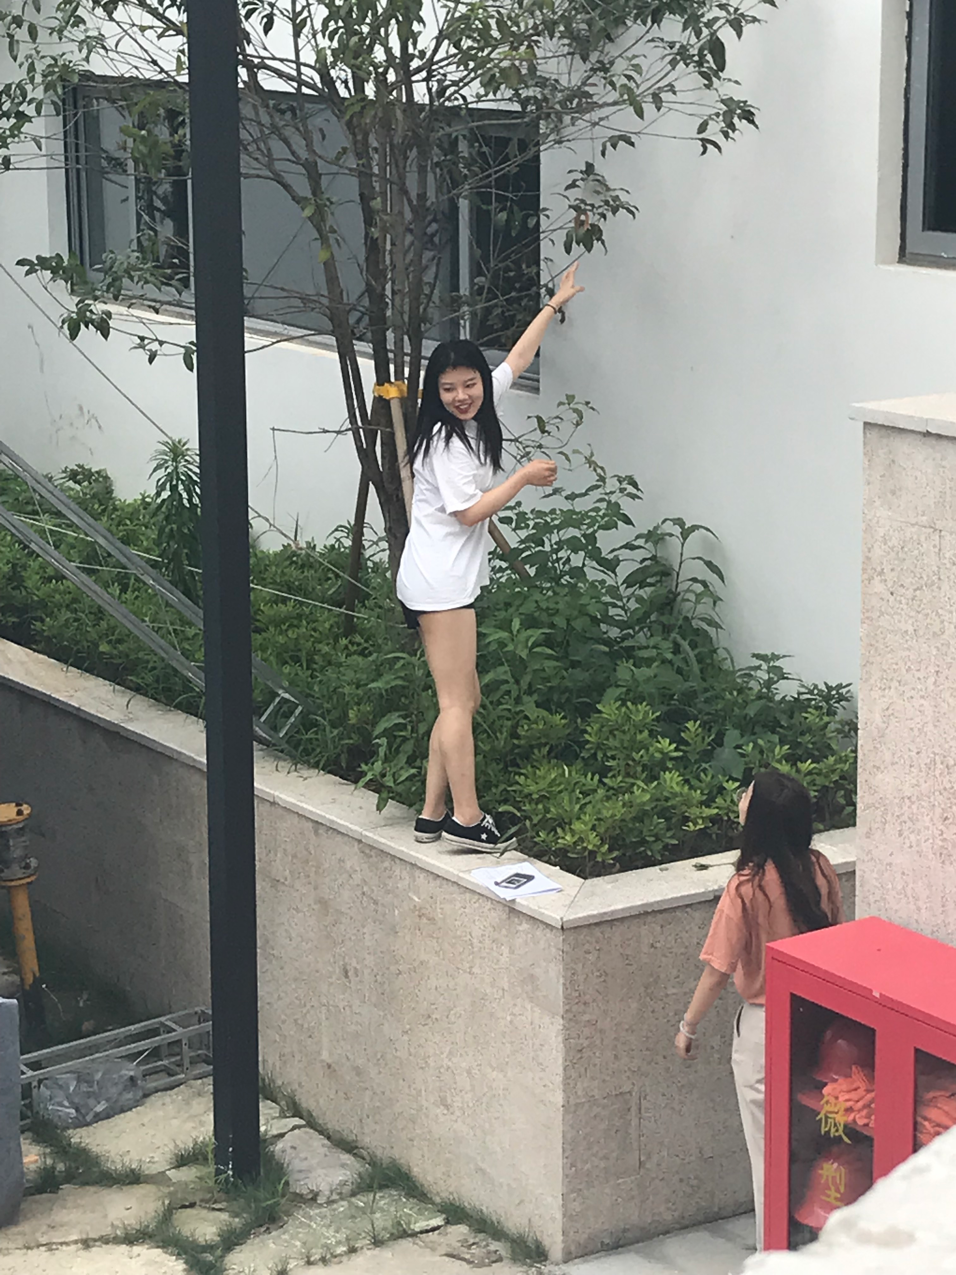
Collecting Data from Campus to Draw

Slide 5
Collecting Personal Data

Slide 6
Week 2, Computational techniques

Slide 7
Learning to code visual forms with HTML and CSS

Slide 8
Learning to look at data with Javascript

Slide 9
Thank You

